Slide 1
American vs british
Differences Between American English and British English in Lexicology

Slide 2
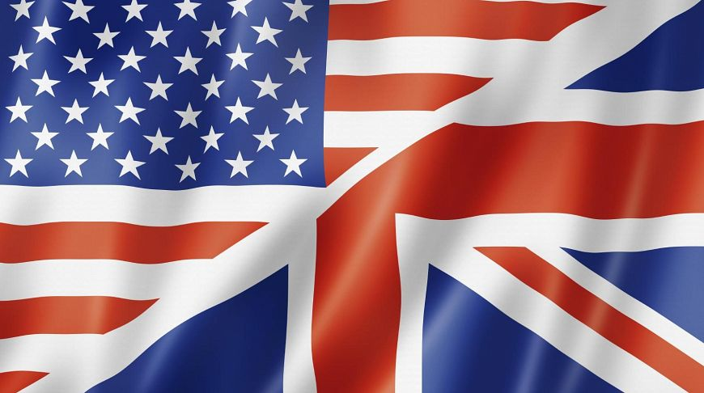
«two nations divided by a common language»

Slide 3
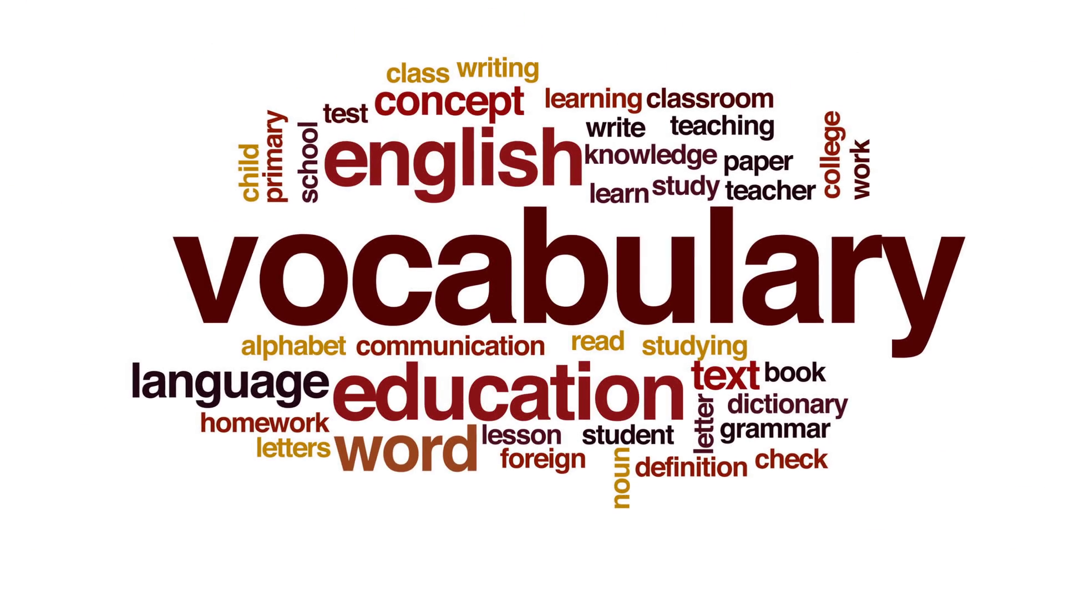
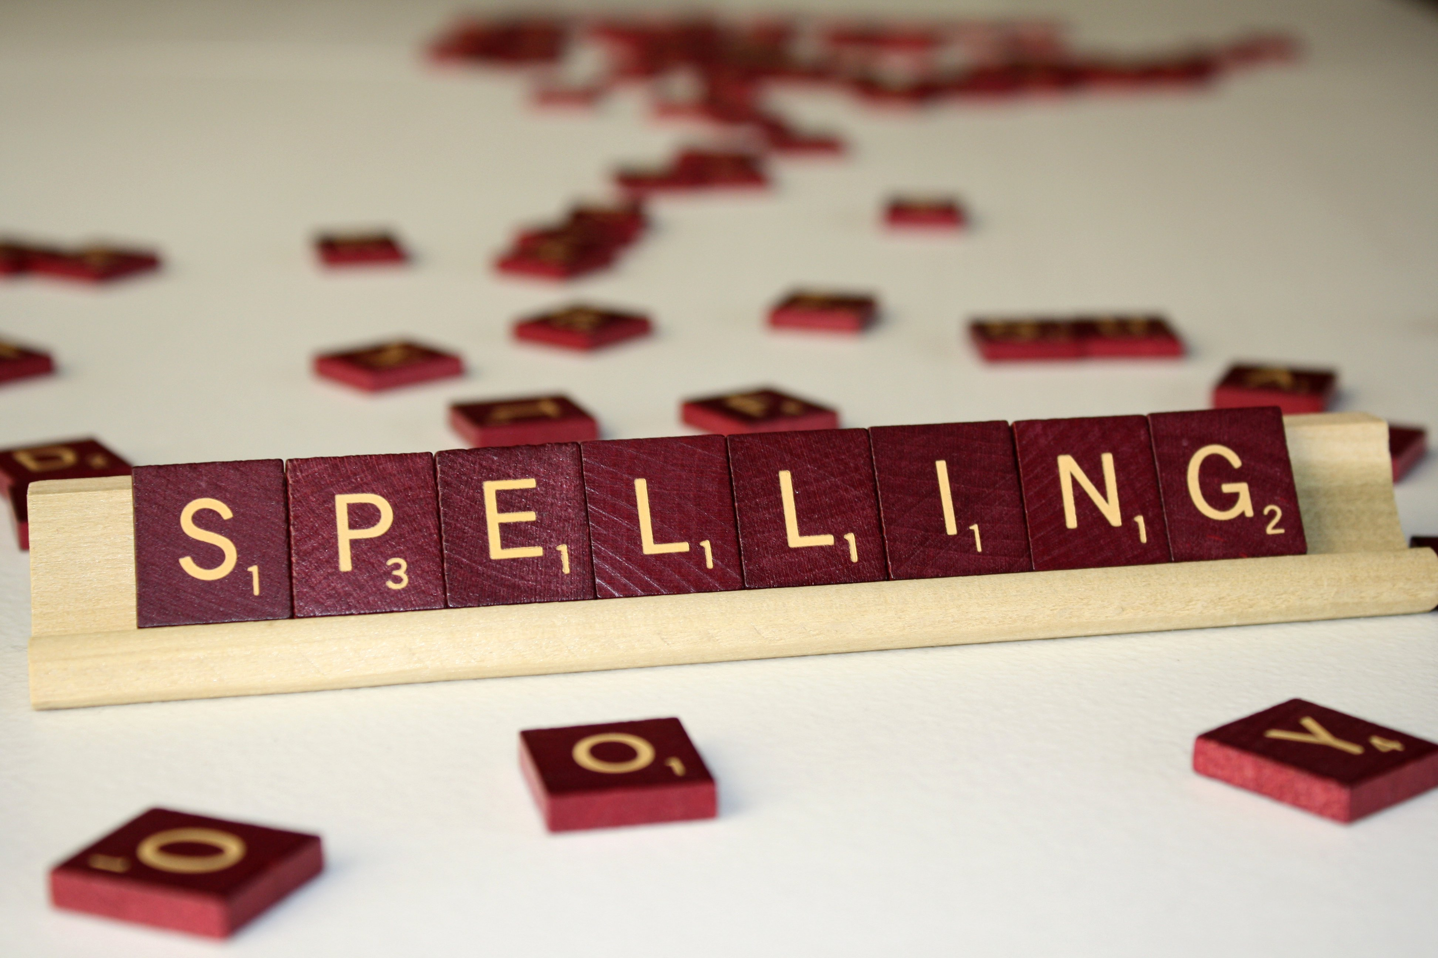

Content:
differences
vocabulary
spelling
grammar

Slide 4

Vocabulary

Slide 5
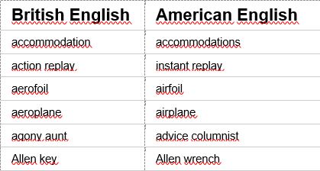
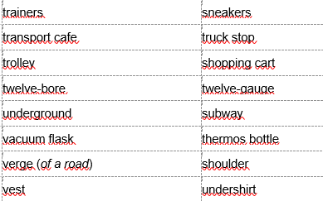
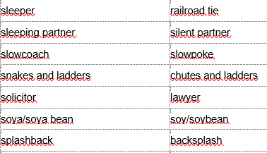
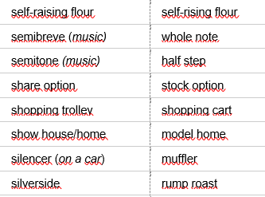
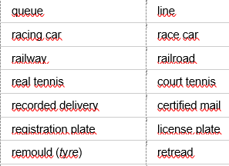

Slide 6


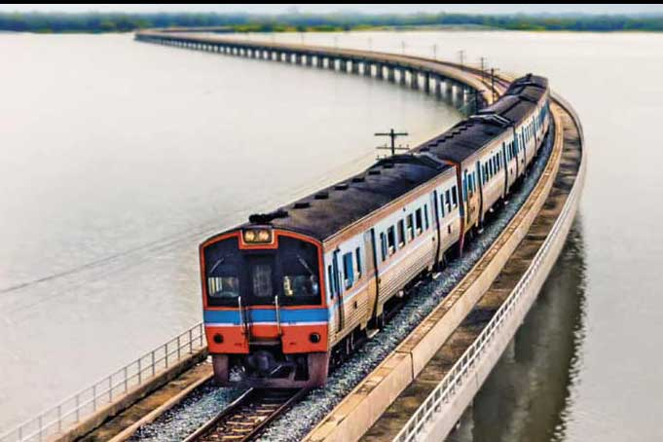
Americans go on vacation, while Brits go on holidays, or hols.
New Yorkers live in apartments; Londoners live in flats.
UK: The train will arrive in precisely fifteen minutes' time. US: The train will arrive in approximately fifteen minutes

Slide 7
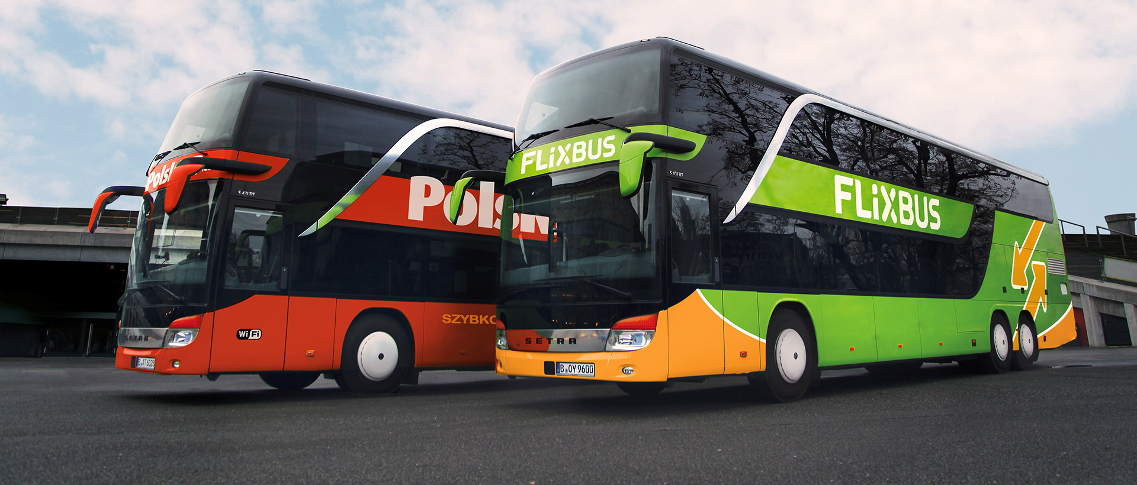
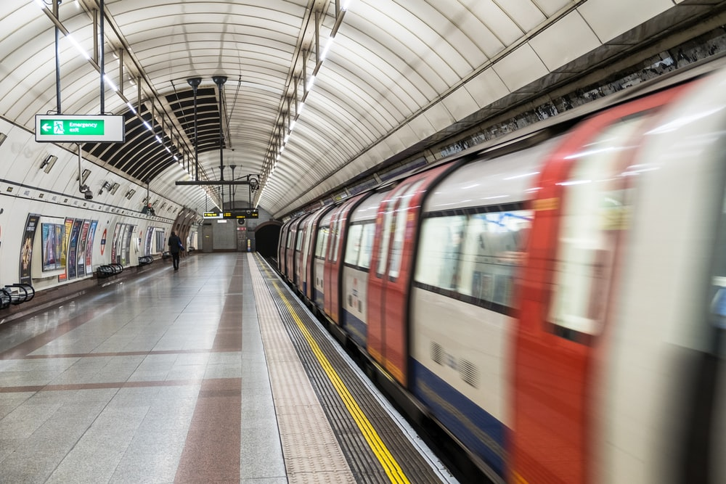
Transport
American
British
bus
couch
subways
underground’

Slide 8
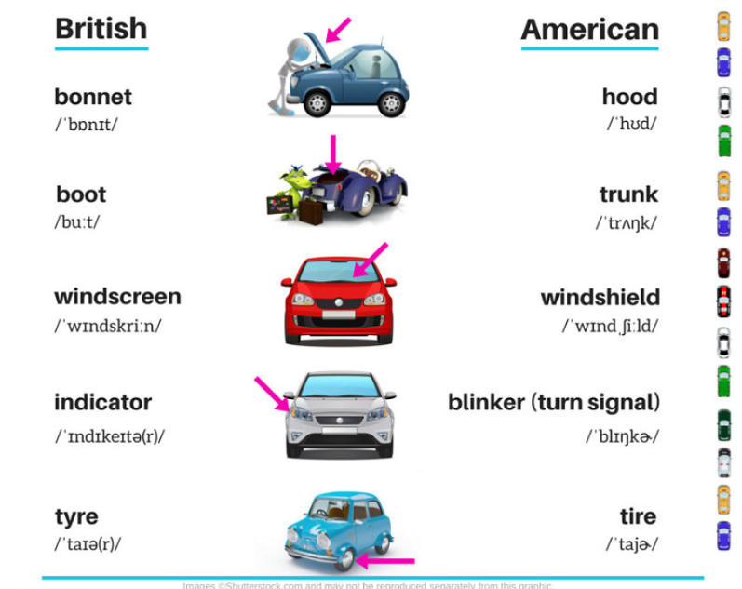
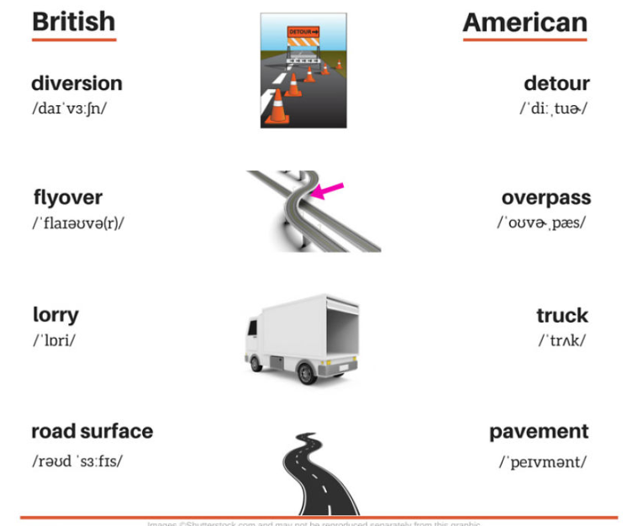

Slide 9

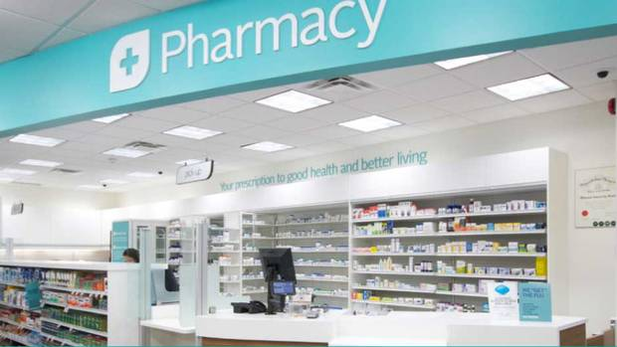
Shopping
British
Americans
store’
'shop’
drugstore’
chemist’s’

Slide 10
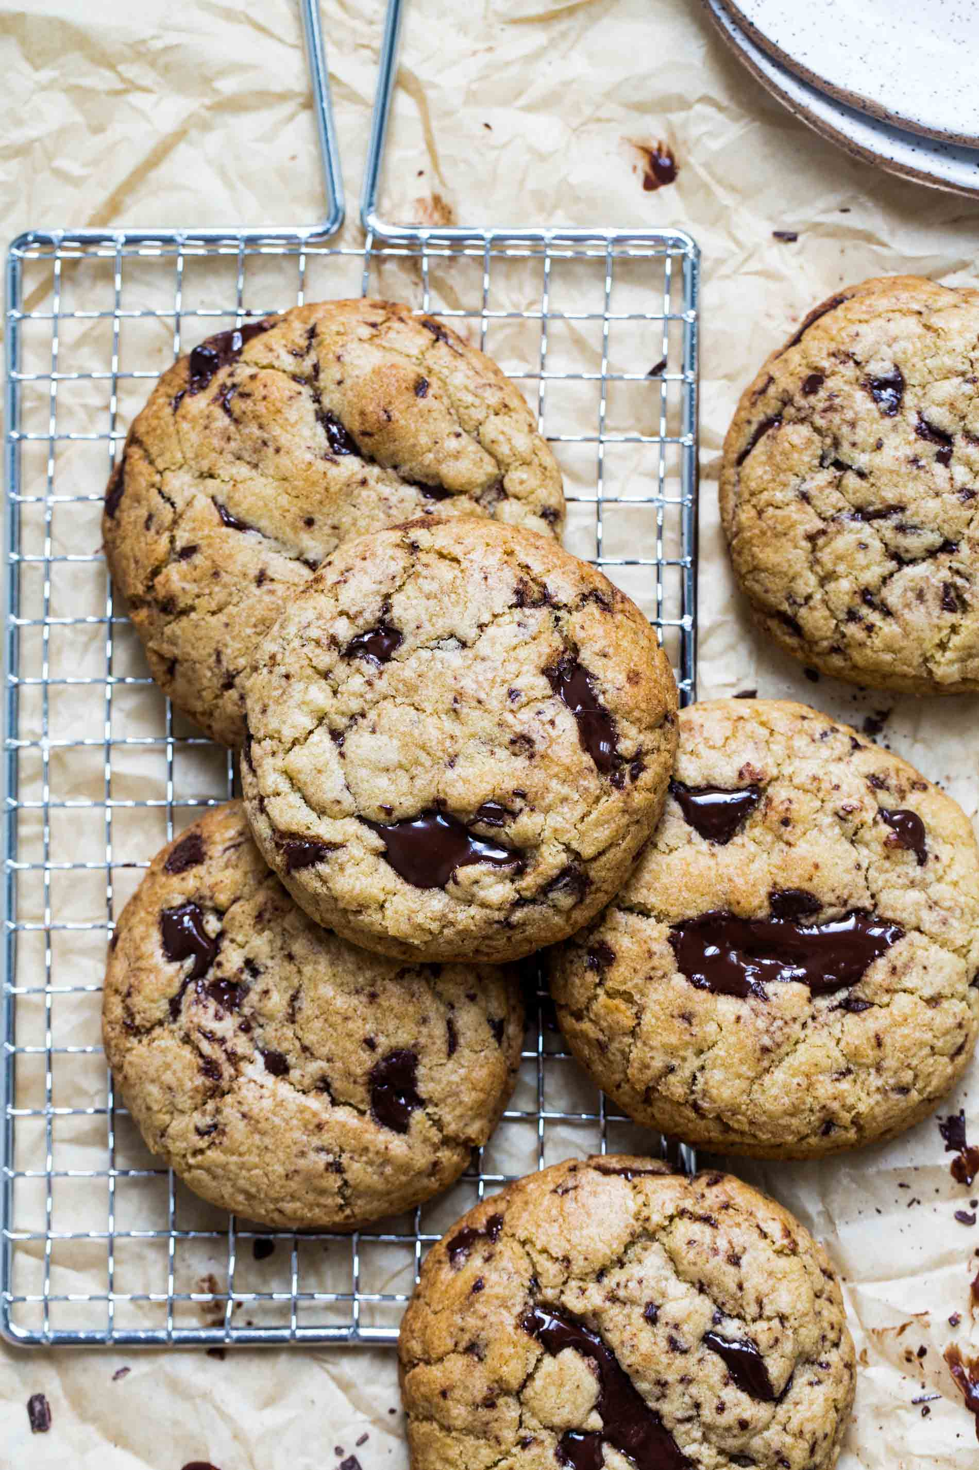
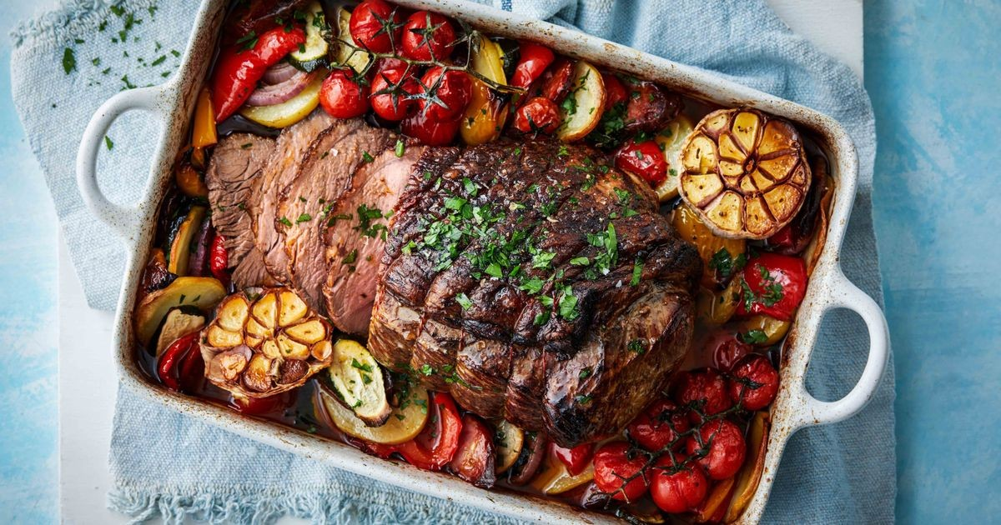

Food
biscuit’
cookie’
aubergines’
eggplants’
roast
joint

Slide 11
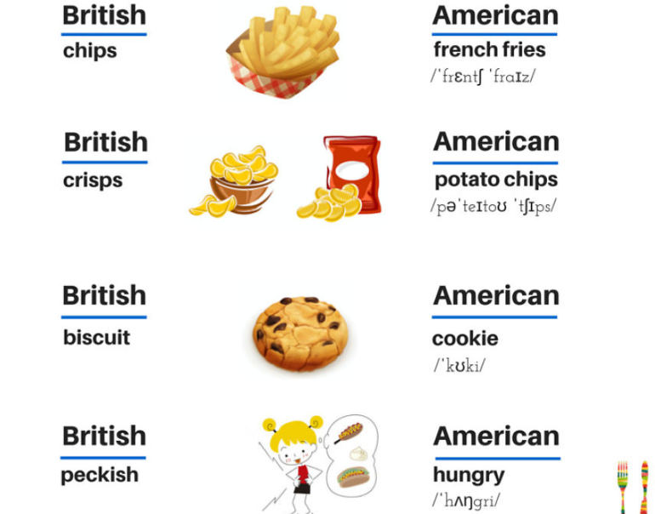
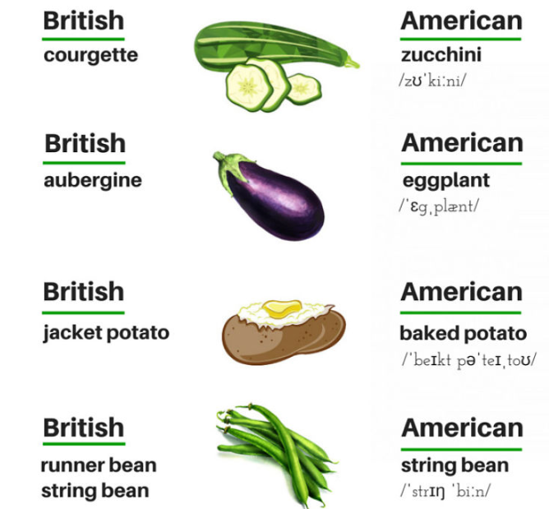

Slide 12
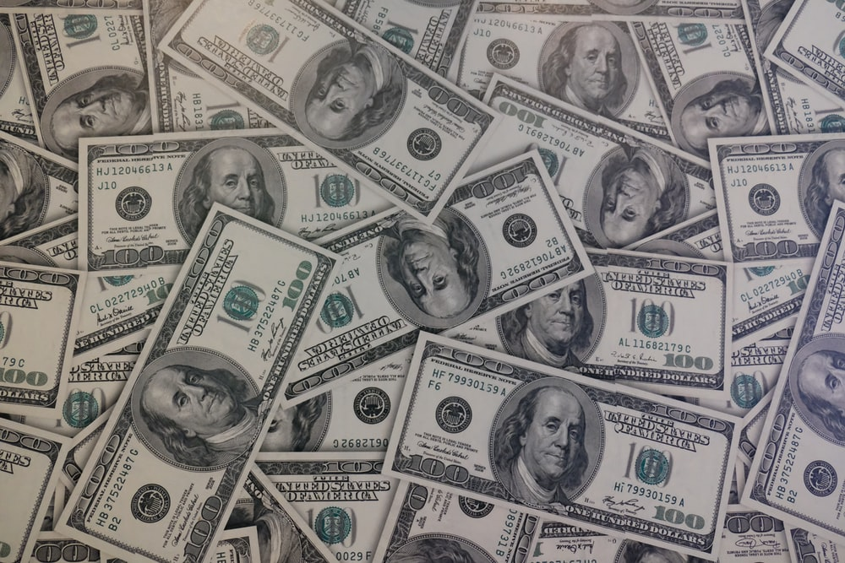
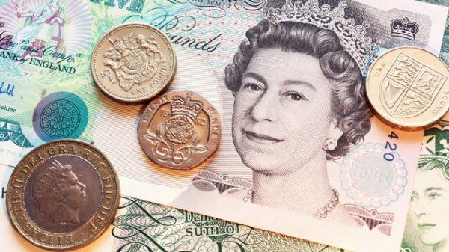
Numbers
one thousand, four hundred and fifty-six
1,456
‘fourteen fifty-six’
three twenty’
three dollars and twenty cents’
$3.20

Slide 13
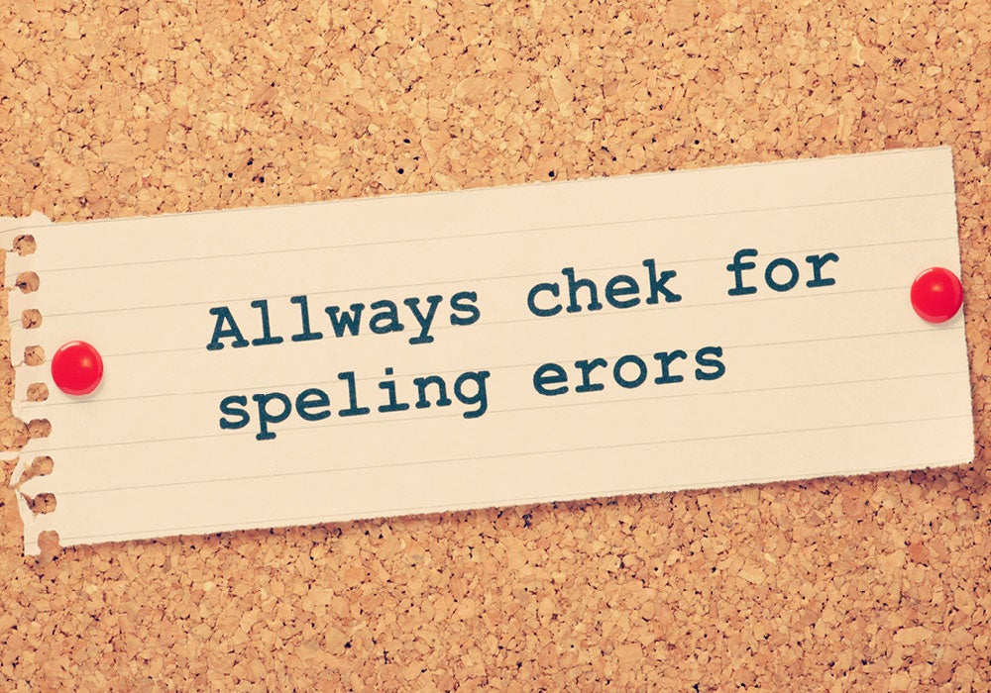
Spelling differences

Slide 14
British English | American English
-oe-/-ae- (e.g. anaemia, encyclopaedia) | -e- (e.g. anemia, encyclopedia)
-t (e.g. burnt, dreamt, leapt) | -ed (e.g. burned, dreamed, leaped)
-ence (e.g. defence, offence, licence) | -ense (defense, offense, license)
-ell- (e.g. cancelled, jeweller, marvellous) | -el- (e.g. canceled, jeweler, marvelous)
-ise (e.g. appetiser, familiarise, organise) | -ize (e.g. appetizer, familiarize, organize)
-l- (e.g. enrol, fulfil, skilful) | -ll- (e.g. enroll, fulfill, skillfull)
-ogue (e.g. analogue, monologue, catalogue) | -og (e.g. analog, monolog, catalog) *Note that American English also recognizes words spelled with –ogue

Slide 15
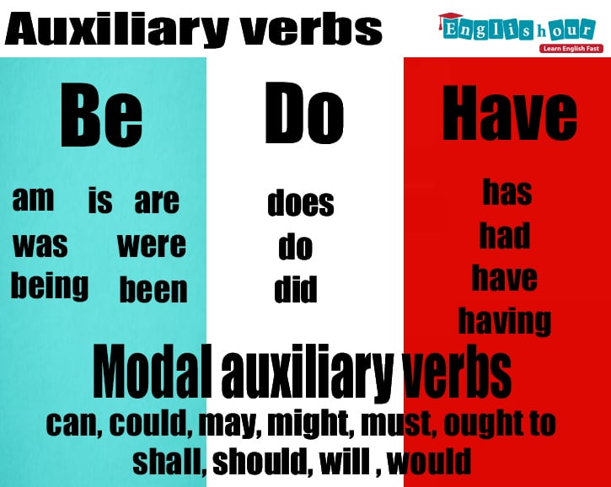
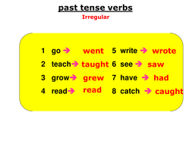
grammar
Auxiliary verbs
Past tense verbs

Slide 16

Auxiliary verbs
“I will go home now.”
“I shall go home now.”
“Should we go now?”
“Shall we go now?”
“You do not need to come to work today.”
“You needn’t come to work today.”

Slide 17
Past tense verbs
Americans
–ed ending
Brits
-t ending
learned
learned or learnt
dreamed
burned
burnt
dreamt
People in both countries can easily understand both ways, although Brits tend to think of the American way as incorrect

Slide 18
Howdy. British: How are you ? American: How you doing ?
In Britain people say “I was sat” or “I was stood” while in American English they would say “I was sitting” or “I was standing”
UK: The train will arrive in precisely fifteen minutes' time. US: The train will arrive in approximately fifteen minutes.
"z" pronunciation American: zee English: zed
American: You like it. British: You fancy it.
The American postal service delivers the mail. The British mail service delivers the post.

Slide 19

Conclusion
While American and British English show some differences in vocabulary related to shopping and other common activities, all evidence suggests that the two varieties of the language are moving closer together. The movement is mostly eastward. Each year, more words that were once exclusively American are found in the spoken and written language of both Britain and the U.S.

